Slide 1
story
Jack and the Beanstalk

Slide 2
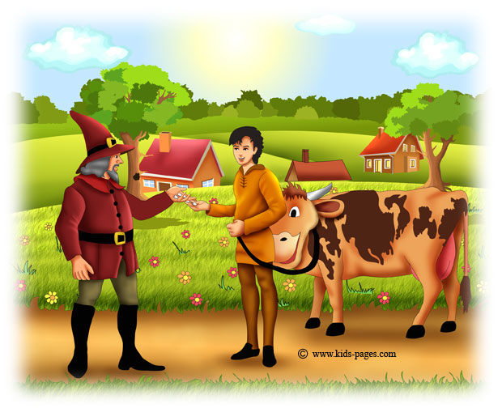

Slide 3
Once upon a time there was a poor widow who lived in a little cottage with her only son Jack. Jack was a giddy, thoughtless boy, but very kind hearted and affectionate. They were very poor and when the widow saw that there was no means of keeping Jack and herself from starvation but by selling her cow she said to her son, "You must take the cow to market and sell her." Jack liked going to market to sell the cow very much; but as he was on the way, he met a butcher who had some beautiful beans in his hand. Jack stopped to look at them, and the butcher told the boy that they were of great value and persuaded the silly lad to sell the cow for these beans.

Slide 4
When he brought them home to his mother instead of the money she expected for her nice cow, she was very vexed and shed many tears, scolding Jack for his folly. He was very sorry, and mother and son went to bed very sadly that night; their last hope seemed gone. At daybreak Jack rose and went out into the garden. "At least," he thought, "I will sow the wonderful beans." So he took a piece of stick, and made some holes in the ground, and put in the beans. That day they had very little dinner, and went sadly to bed, knowing that for the next day there would be none, and Jack, unable to sleep from grief and vexation, got up at day-dawn and went out into the garden.

Slide 5
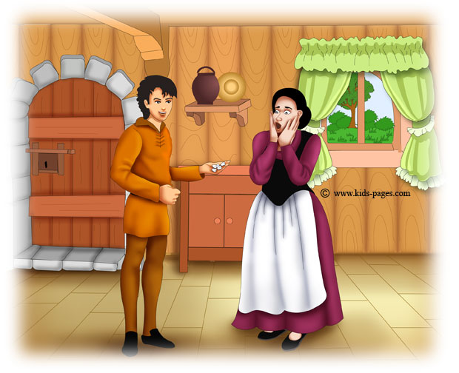

Slide 6
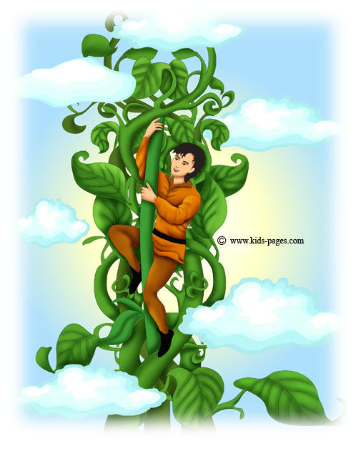

Slide 7
What was his amazement to find that the beans had grown up in the night, and climbed up and up until they covered the high cliff that sheltered the cottage and disappeared above it! The stalks had twined and twisted themselves together until they formed quite a ladder. "It would be easy to climb it," thought Jack. Jack instantly began to climb, and went up and up on the ladder-like beanstalk until everything he had left behind him -- the cottage, the village, and even the tall church tower -- looked quite little, and still he could not see the top of the beanstalk.

Slide 8
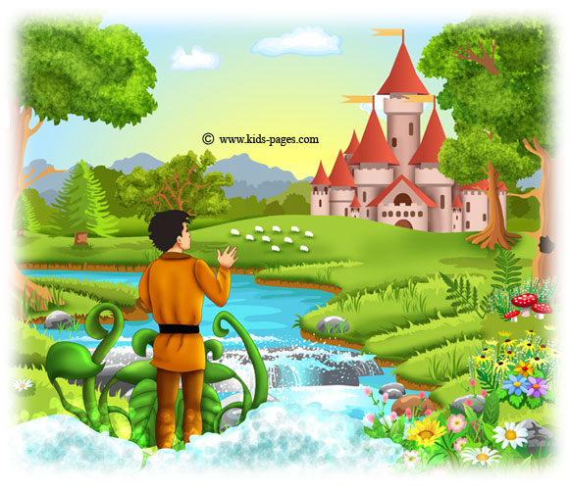

Slide 9
After climbing higher and higher, Jack at last reached the top of the beanstalk, and found himself in a beautiful country, finely wooded, with beautiful meadows covered with sheep. A crystal stream ran through the pastures; not far from the place where he had got off the beanstalk stood a fine, strong castle. Jack wondered very much that he had never heard of or seen this castle before.

Slide 10
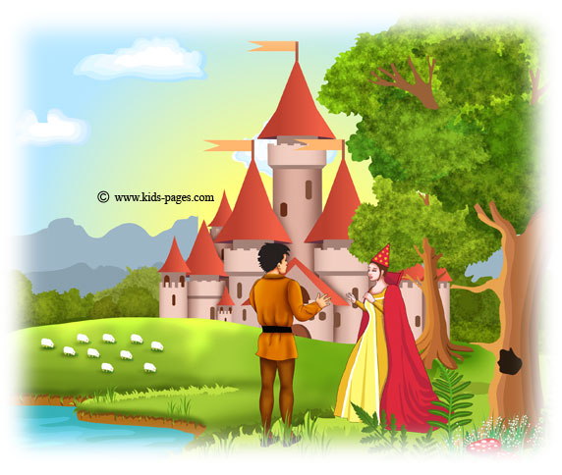

Slide 11
While Jack was standing looking at the castle, a very beautiful woman came out of the wood, and advanced towards him. Jack made her a bow. "If you please, ma'am," said he, "is this your house?" "No," said the lady. "Listen, and I will tell you the story of that castle:" Once upon a time there was a noble knight, who lived in this castle, which is on the borders of fairyland. He had a fair and beloved wife and a lovely little boy. He had many treasures and a monstrous giant, who lived at no great distance, resolved to obtain possession of them so he killed him one night while he was sleeping. Happily for her, the lady had gone with her infant son to visit her old nurse, who lived in the valley. The lady heard what had happened and she decided to remain at her nurse's house as the best place of concealment. Years rolled on. The old nurse died, leaving her cottage to her poor lady, who dwelt in it, working as a peasant for her daily bread. Jack, that poor lady is your mother. This castle was once your father's, and must again be yours. Jack uttered a cry of surprise. "My mother! Oh, madam, what ought I to do? My poor father! My dear mother!" "Your duty requires you to win it back for your mother. But the task is a very difficult one, Jack. Have you courage to undertake it?" "I fear nothing when I am doing right," said Jack. "Then," said the lady, you must get into the castle, and if possible possess yourself of a hen that lays golden eggs, and a harp that talks. Remember, all that giant possesses is really yours." As she ceased speaking, the lady of the red hat suddenly disappeared, and of course Jack knew she was a fairy.

Slide 12
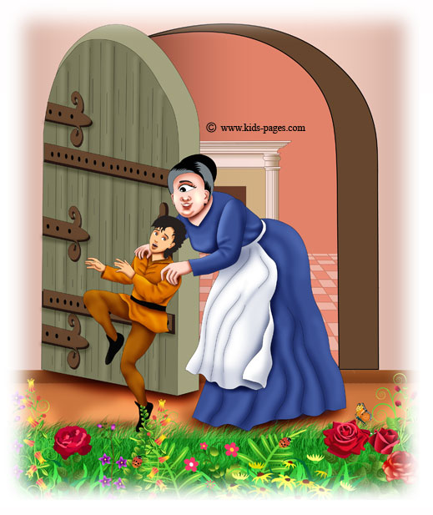

Slide 13
Jack determined at once to attempt the adventure; so he advanced, and blew the horn which hung at the castle portal. The door was opened in a minute or two by a frightful giantess, with one great eye in the middle of her forehead. As soon as Jack saw her he turned to run away, but she caught him, and dragged him into the castle. "You shall be my boy, she said. You shall clean the knives, and black the boots, and make the fires, and help me generally when the giant is out. When he is at home I must hide you, for he has eaten up all my pages hitherto, and you would be a dainty morsel, my little lad." While she spoke she dragged Jack right into the castle. “Come here, child; go into my wardrobe. He never ventures to open that. You will be safe there." And she opened a huge wardrobe which stood in the great hall, and shut him into it.

Slide 14
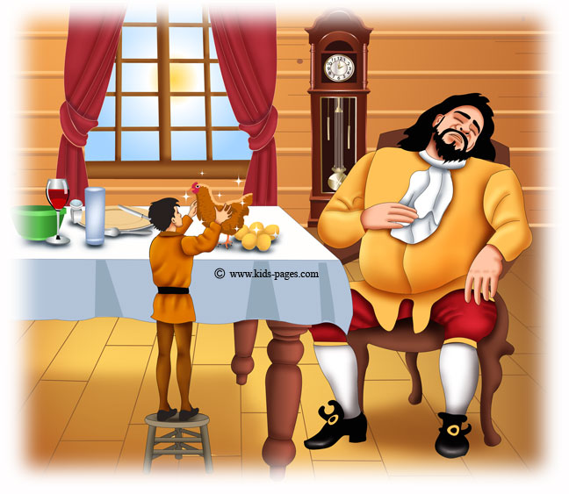

Slide 15
By and by he heard a heavy tramp on the stairs, like the lumbering along of a great cannon, and then a voice like thunder cried out. Fe, fa, fi-fo-fum, I smell the breath of an Englishman. Let him be alive or let him be dead, I'll grind his bones to make my bread. "Wife," cried the giant, "there is a man in the castle. Let me have him for breakfast." "You are grown old and stupid," cried the lady in her loud tones. "It is only a nice fresh steak of an elephant that I have cooked for you which you smell." And she placed a huge dish before him of savory steaming meat. When he had breakfasted he bade his wife bring him his hen that laid the golden eggs. The giantess went away, and soon returned with a little brown hen, which she placed on the table before her husband. After that, she left the room. Then he took up the brown hen and said to her, "Lay!" And she instantly laid a golden egg. By and by the giant put the hen down on the floor, and soon after went fast asleep. Jack pushed open the door of the wardrobe and crept out. Very softly he stole across the room, and, picking up the hen, made haste to quit the apartment and flew back to the beanstalk, which he descended as fast as his feet would move. When his mother saw him enter the house she wept for joy. But Jack put the brown hen down before her, and told her how he had been in the giant's castle, and all his adventures. She was very glad to see the hen, which would make them rich once more.

Slide 16
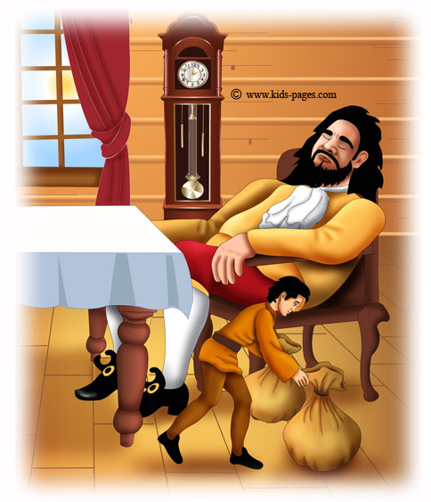

Slide 17
Jack made another journey up the beanstalk to the giant's castle one day while his mother had gone to market. The giantess dragged him in as she had done before to help her do the work; but she heard her husband coming, and hid him in the wardrobe. Then the giant came in saying: Fe, fa, fi-fo-fum, I smell the breath of an Englishman. Let him be alive or let him be dead, I'll grind his bones to make my bread. "Nonsense!" said the wife, "it is only a roasted bullock that I thought would be a tit-bit for your supper; sit down and I will bring it up at once." The giant sat down, and soon his wife brought up a roasted bullock on a large dish, and they began their supper. As soon as they had finished their meal, the giant asked his wife to bring him his money bags to count his golden pieces. The giantess went and soon returned with two large bags over her shoulders, which she put down by her husband. The giant, when his wife was gone, took out heaps and heaps of golden pieces, and counted them, and put them in piles, until he was tired of the amusement. Then he swept them all back into their bags, and leaning back in his chair fell fast asleep. Jack stole softly out of the wardrobe, and taking up the bags of money (which were his very own, because the giant had stolen them from his father), he ran off, and with great difficulty descending the beanstalk, laid the bags of gold on his mother's table. "There, mother, I have brought you the gold that my father lost." Jack's mother was very glad to get the money, but she did not like him to run any risk for her.

Slide 18
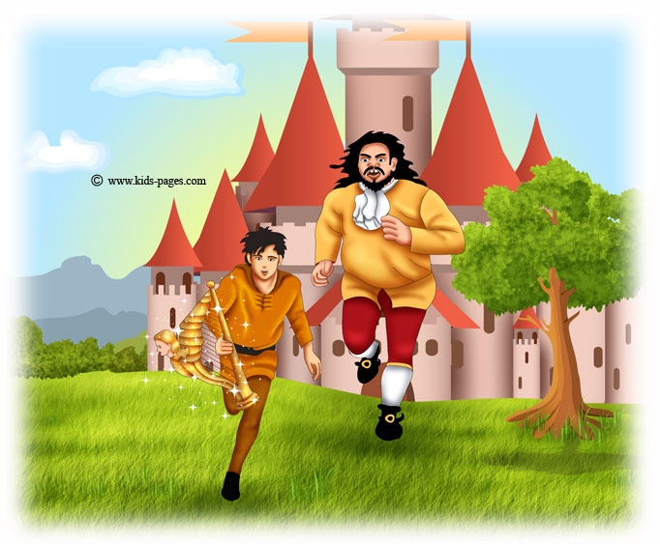

Slide 19
But after a time Jack made up his mind to go again to the giant's castle. So he climbed the beanstalk once more, and blew the horn at the giant's gate. The giantess soon opened the door and she bade him come in, and again hid him away in the wardrobe. By and by the giant came home, and as soon as he had crossed the threshold he roared out: Fe, fa, fi-fo-fum, I smell the breath of an Englishman. Let him be alive or let him be dead, I'll grind his bones to make my bread. "You stupid old giant," said his wife, "you only smell a nice sheep, which I have grilled for your dinner." When he had eaten it all up, he said, "Now bring me my harp, and I will have a little music while you take your walk." The giantess obeyed, and returned with a beautiful harp. The framework was all sparkling with diamonds and rubies, and the strings were all of gold. "This is one of the nicest things I took from the knight," said the giant. So he drew the harp towards him, and said, "Play!" And the harp played a nice tune to the sound of which its master fell asleep. Then Jack stole softly out of the wardrobe, seized the harp and ran away with it; but as he jumped over the threshold the harp called out, "Master! Master!" And the giant woke up. With a tremendous roar he sprang from his seat, and in two strides had reached the door. But Jack was very nimble. He fled like lightning with the harp, talking to it as he went (for he saw it was a fairy), and telling it he was the son of its old master, the knight.

Slide 20
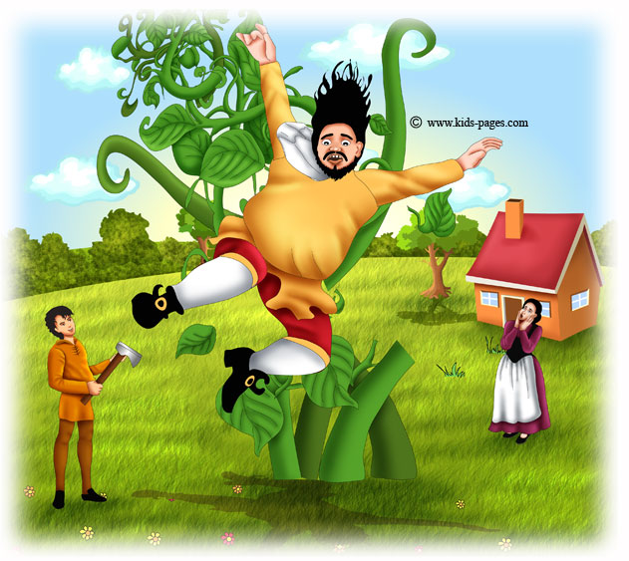

Slide 21
Just as he reached their own garden, Jack beheld the giant descending after him. "Mother! mother!" cried Jack, "make haste and give me the ax." His mother ran to him with a hatchet in her hand, and Jack with one tremendous blow cut through all the stems except one. "Now, mother, stand out of the way!" said he. Down came the giant with a terrible crash and lay dead at the feet of the woman he had so much injured. Before Jack and his mother had recovered from their alarm and agitation, the beautiful lady stood before them. "Jack," said she, "you have acted like a brave knight's son, and deserve to have your inheritance restored to you. Return to the castle, and act as you will find needful." She told him that she would drive him there in her chariot, which was drawn by two peacocks. Jack thanked her, and sat down in the chariot with her. The fairy drove him a long distance round, until they reached a village which lay at the bottom of the hill. Here they found a number of miserable-looking men assembled. The fairy stopped her carriage and addressed them. "My friends," said she, "the cruel giant who oppressed you and ate up all your flocks and herds is dead, and this young gentleman was the means of your being delivered from him, and is the son of your kind old master, the knight." The men gave a loud cheer at these words, and pressed forward to say that they would serve Jack as faithfully as they had served his father. The fairy bade them follow her to the castle, and they marched thither in a body, and Jack blew the horn and demanded admittance. The old giantess saw them coming from the turret loop hole. She was very much frightened, for she guessed that something had happened to her husband; and as she came downstairs very fast she caught her foot in her dress, and fell from the top to the bottom and broke her neck.

Slide 22
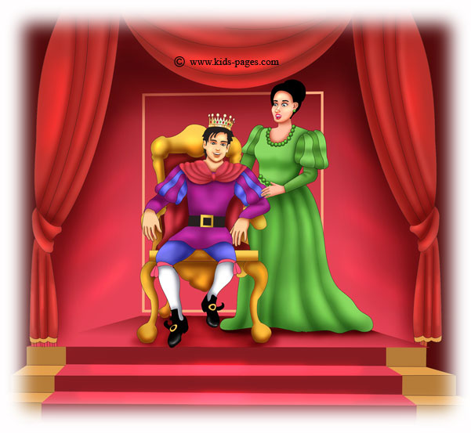

Slide 23
When the people outside found that the door was not opened to them, they took crowbars and forced the portal. Nobody was to be seen, but on leaving the hall they found the body of the giantess at the foot of the stairs. Thus Jack took possession of the castle. The fairy went and brought his mother to him, with the hen and the harp. He had the giantess buried, and endeavored as much as lay in his power to do right to those whom the giant had robbed.

